Slide 1
Improved Methods for Automated Corn Leaf Disease Recognition
Abu Zahed
221-15-4716
Department of CSE
Daffodil International University
Mr. Mayen Uddin Mojumdar
Sr. Lecturer
Department Of CSE
Daffodil International University

Slide 2
Outline
Introduction
Problem Statement
Motivation and Objective
Related Works
Comparison Between Existing Works
Gap Analysis
Proposed Methodology
Q & A

Slide 3
Introduction
Corn is an important crop worldwide and in Bangladesh, People use it for food, animal feed. but some diseases like Corn Leaf Blight, Common Rust, and Gray Leaf Spot damage the leaves and reduce the amount of crop yield and quality.
Usually, farmers check the leaves by looking at them. This takes time and can be wrong sometimes, especially in real field conditions
Recent research shows that Deep Learning, especially Convolutional Neural Networks (CNNs), can detect plant diseases from images with high accuracy. But many existing models are large, need powerful computers, and are not practical for use in rural farming areas without stable internet.
This research develops a lightweight CNN model for detecting six types of corn leaf diseases from a custom, field-collected dataset in Bangladesh. The dataset was preprocessed using resizing, denoising, normalization, and balanced using data augmentation.

Slide 4
Problem Statement
High Crop Losses – Corn leaf diseases like Corn Leaf Blight, Common Rust, and Gray Leaf Spot cause severe yield and quality reduction.
Limitations of Manual Inspection – armers check leaves by looking at them, which is slow, depends on their judgment, and can be wrong especially in different lighting or field conditions.
Lack of Accessible AI Solutions many AI models that can detect diseases are too large and need expensive hardware, so they are not practical for rural farmers.
Limited Multi-Disease Capability – Few lightweight systems can accurately detect and classify multiple corn leaf diseases from field images.
Data Imbalance Issues – Real-world datasets ften have unequal numbers of images for each disease, which reduces accuracy.
Deployment Challenges – Existing solutions are rarely optimized for offline, low-resource environments like rural farms.

Slide 5
Motivation and Objective
Motivation | Objectives
Maize is a key food, feed, and biofuel crop worldwide, crucial for rural livelihoods and national economies. | Develop an AI-based system to detect and classify multiple maize leaf diseases accurately.
Leaf diseases cause significant yield losses and threaten food security. | Ensure the system works in real field conditions with complex backgrounds and varying lighting.
Farmers often lack quick and accurate tools to identify diseases in early stages. | Use deep learning models (e.g., CNN, DenseNet, MobileNet) for automated disease recognition.
Advances in AI and Deep Learning make it possible to detect diseases automatically from leaf images. | Provide farmers with a fast, reliable, and user-friendly tool for early intervention.
An intelligent detection system can save time, reduce costs, and prevent large-scale crop damage. | Contribute to sustainable agriculture and improved food security.

Slide 6
Related Works
Fraiwan et al., 2022 – Used TL-AlexNet, VGG16, and ResNet50 for corn leaf disease classification via transfer learning without preprocessing.
Li et al., 2023 – Proposed MDCDenseNet (DenseNet121 + CBAM + multi-dilated) for improved feature extraction on small, complex datasets.
Xu et al., 2023 – Applied ResNet50 + ECA for multi-task detection of both pests and diseases.
Dai et al., 2023 – Introduced MTDL-EPDCLD (MobileNetV3-Attention) as a two-step pipeline for enhanced precision detection of corn leaf diseases.
Tariq et al., 2024 – Used VGG16 + LRP (with ResNet referenced in methodology) for explainable AI.
Gopalan et al., 2025 – Used ResNet152 + Grad-CAM for visual explanation of predictions.

Slide 7
Comparison Between Existing Works
Author(s) | Model(s) | Accuracy | Contribution
Fraiwan et al., 2022 | TL-AlexNet /VGG16 / ResNet50 | 98.6% | Used transfer learning without preprocessing; achieved high accuracy on corn disease classification.
Li et al., 2023 | MDCDenseNet (DenseNet121 + CBAM + multi-dilated) | 97.9% | Proposed an improved DenseNet with attention modules for better feature extraction on small, complex datasets.
Khan et al., 2023 | YOLOv8n detector (mobile) | 99.04% | Built a mobile-based detection system for multiple corn diseases with real-time performance.
Waheed et al., 2020 | Pruned DenseNet | 98.06% | Optimized DenseNet for reduced computation while maintaining high accuracy.
Mohanty et al., 2023 | ResNet50-GAP + VGG19 fusion | 99.65% | Combined two CNN architectures for enhanced feature fusion and improved classification accuracy.

Slide 8
Gap Analysis
Large Model Sizes – Many high-performing CNN models (DenseNet, ResNet152, large ensembles) are too heavy for efficient mobile or edge deployment.
Lack of Real-Time Mobile Solutions – Few existing systems are optimized for offline, real-time corn leaf disease detection in rural farming areas.
Multi-Disease Limitation – Several works focus on a single disease, limiting their usefulness for detecting multiple corn leaf diseases.
Class Imbalance Issues – Many datasets suffer from unequal class distribution, reducing accuracy for minority disease classes.
Limited Field Testing – Few models are validated with real field images under varying lighting, occlusion, and background conditions in Bangladesh.

Slide 9
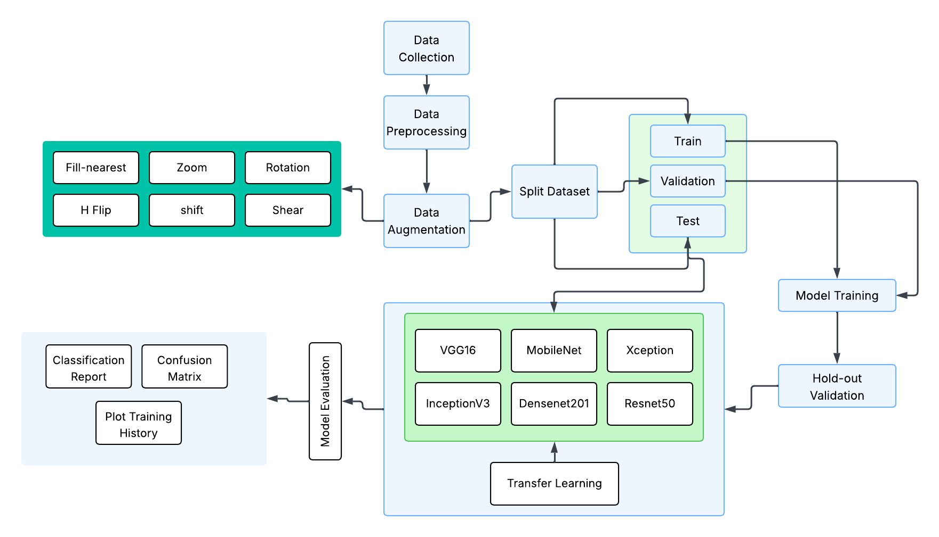
Proposed Methodology

Slide 10
THANK YOU

